Slide 1


Vivekananda College of Engineering & Technology
[A Unit of Vivekananda Vidyavardhaka Sangha Puttur®]
Affiliated to Visvesvaraya Technological University
Approved by AICTE New Delhi & Recognised by Govt of Karnataka
DEPARTMENT OF CSE ( DATA SCIENCE )
Project Phase I Presentation on
Web-Based Automatic Timetable Scheduler for Colleges
Presented by : Gaurav G Alva
4VP22CD019
Harshit M Naik
4VP22CD022
Prapthi J P
4VP22CD037
Supreetha N S
4VP22CD058
Guided by : Prof. Chaithanya D

Slide 2
Introduction
Timetable scheduling is a core administrative task in educational institutions that involves managing multiple constraints such as faculty availability, course requirements, and class distribution. Traditionally, this process is carried out manually, which is time-consuming and prone to errors. With increasing academic complexity, the need for an automated system capable of efficiently generating accurate and conflict-free timetables has become evident. This requirement is addressed by the Web-Based Automatic Timetable Scheduler, which provides a comprehensive web-based solution for automated timetable generation..

Slide 3
Objectives
To automate timetable creation and eliminate inefficiencies and errors caused by manual scheduling.
To use a Genetic Algorithm to optimize course and faculty allocation while satisfying hard constraints and minimizing soft constraint violations.
To provide a user-friendly interface for easy data input, schedule modification, and timetable visualization.
To ensure accurate and reliable timetable generation through validation checks and conflict detection mechanisms.

Slide 4
Problem Statement
Timetable scheduling is an essential administrative activity in educational institutions that involves coordinating faculty, courses, and class schedules. As academic structures become more complex, effective scheduling plays a crucial role in ensuring smooth institutional functioning. To support this requirement, the Web-Based Automatic Timetable Scheduler provides a centralized and automated platform for generating academic timetables in an efficient and organized manner.

Slide 5
Proposed Solution
The proposed solution is a Web-Based Automatic Timetable Scheduler designed to automate the process of academic timetable generation. The system uses a Genetic Algorithm to produce optimized and conflict-free timetables based on predefined academic constraints such as faculty availability, course requirements, and lab allocations. Through a user-friendly web interface, administrators can easily manage academic data and generate timetables efficiently. The solution minimizes manual effort, improves scheduling accuracy, and provides flexibility to handle institutional scheduling needs.

Slide 6
Methodology
The methodology followed here begins with collecting academic data such as departments, courses, faculty details, and availability preferences through a web-based interface. This data is processed using a Genetic Algorithm, which generates multiple timetable solutions and iteratively improves them by minimizing conflicts and satisfying scheduling constraints. The best solution is selected based on fitness evaluation and presented as the final timetable, ensuring efficiency and accuracy in scheduling.

Slide 7
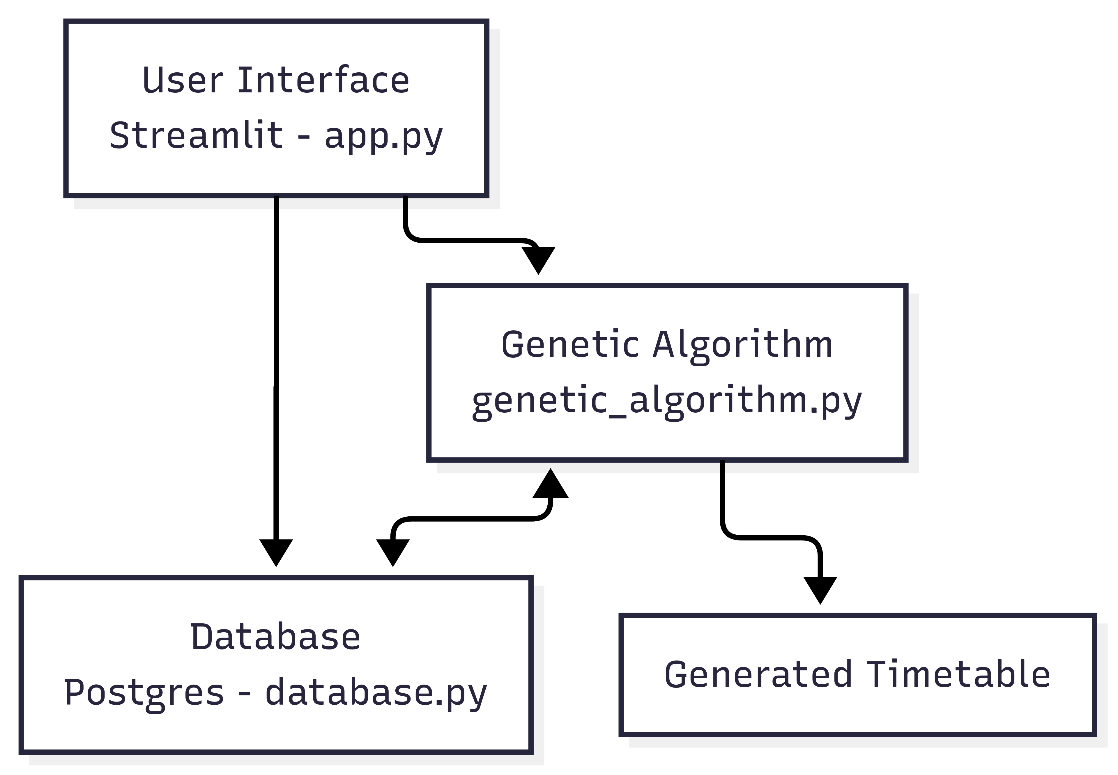
System Architecture
The Architecture follows 3-layered modular approach.
User Interface is developed using Streamlit used for form-based input and data visualization.
The Genetic Algorithm serves as the core optimization engine, generating conflict-free timetables by evaluating multiple scheduling solutions. Genetic Algorithm parameters such as population size, crossover rate, mutation rate, and number of generations control the optimization process and influence the quality of the generated timetable.
Academic and scheduling data is stored and managed using a database.
The final optimized timetable is generated and displayed to the user through the web interface.
Figure : The System Architecture of Web-based Automatic Timetable Scheduler

Slide 8
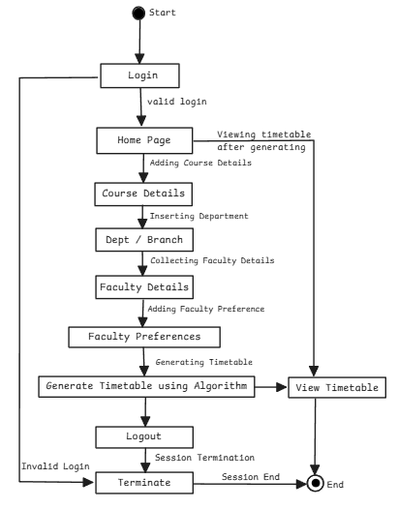
Flow Chart
Figure: The system flow diagram of Web-Based Automatic timetable scheduler

Slide 9
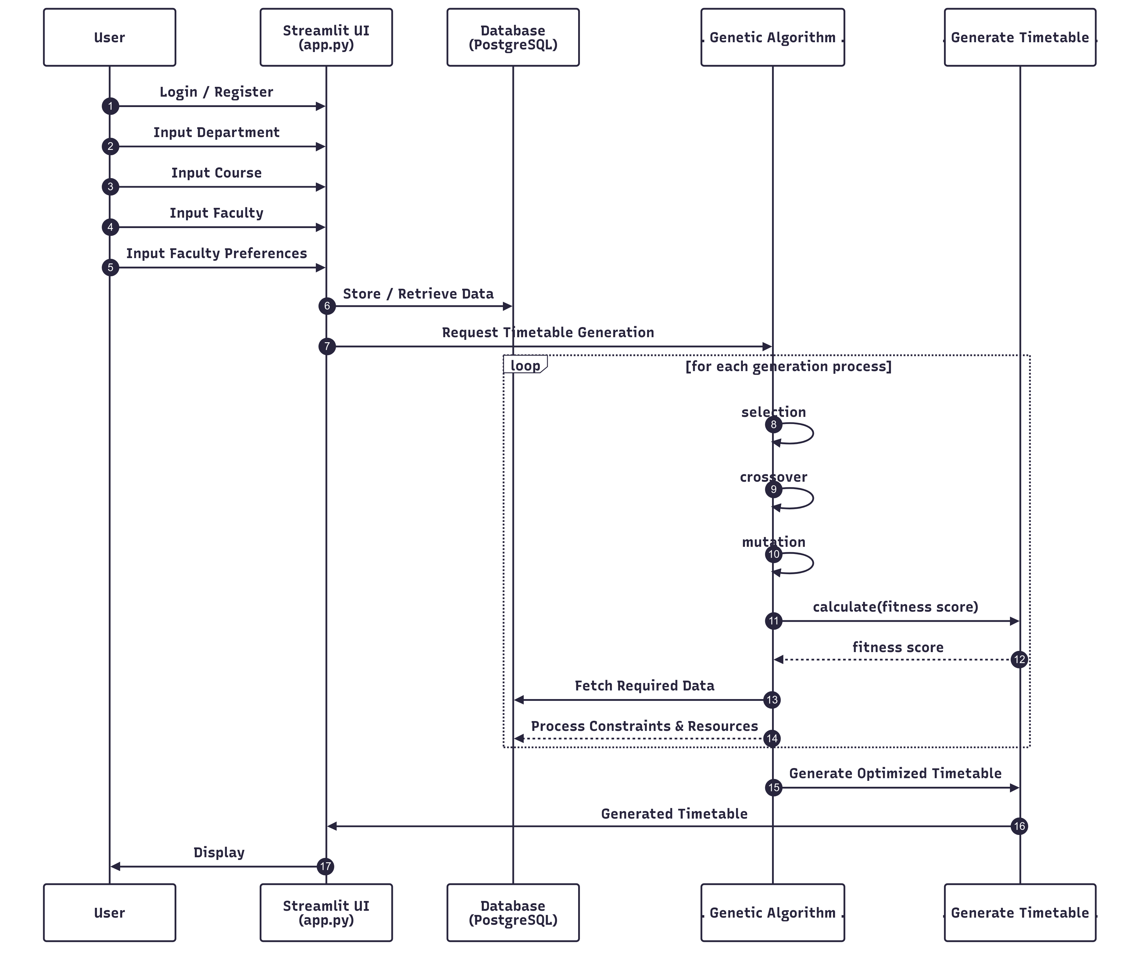
Figure : The activity diagram provides a detailed workflow of the web-based timetable scheduling system, focusing on user interactions and system functions.

Slide 10
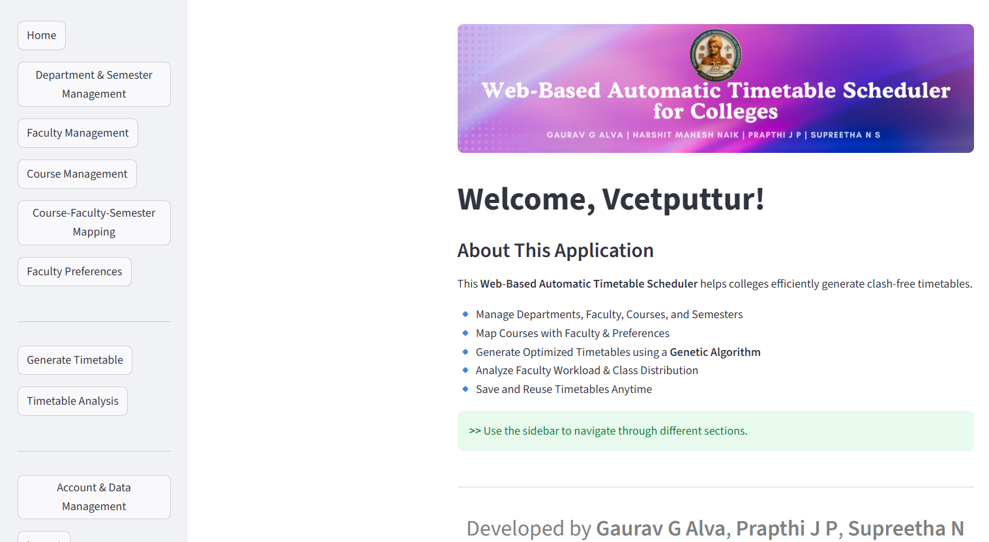
Screenshots
Home Page with the Instruction for timetable generation

Slide 11
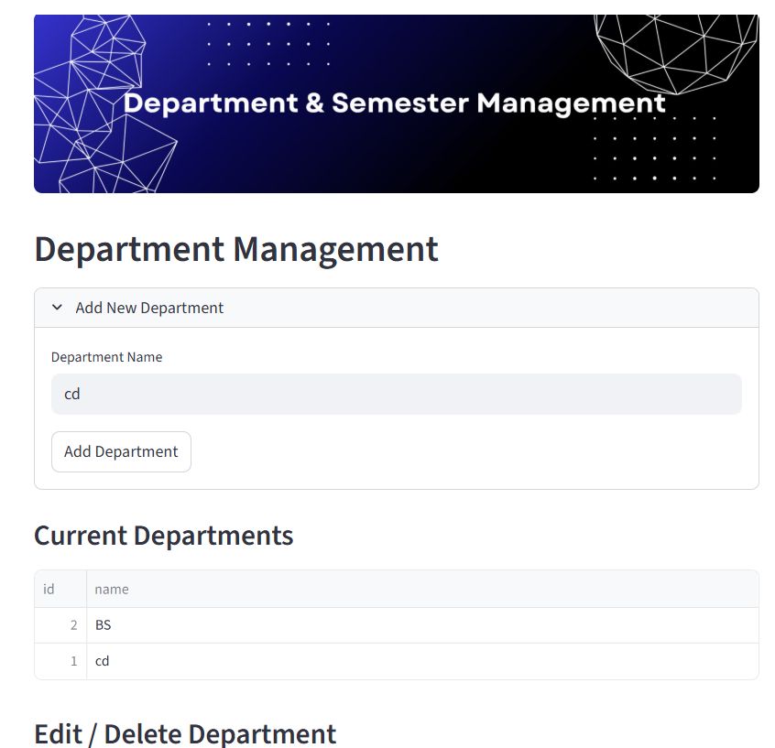
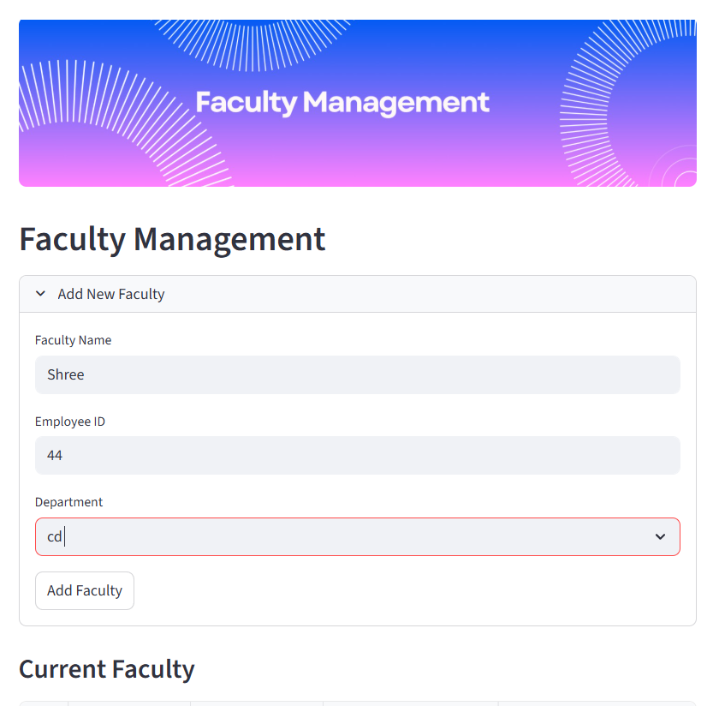
Department, Semester and faculty management page

Slide 12
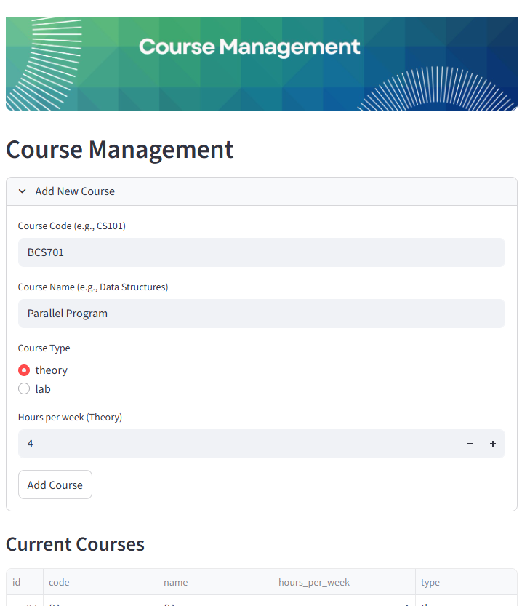
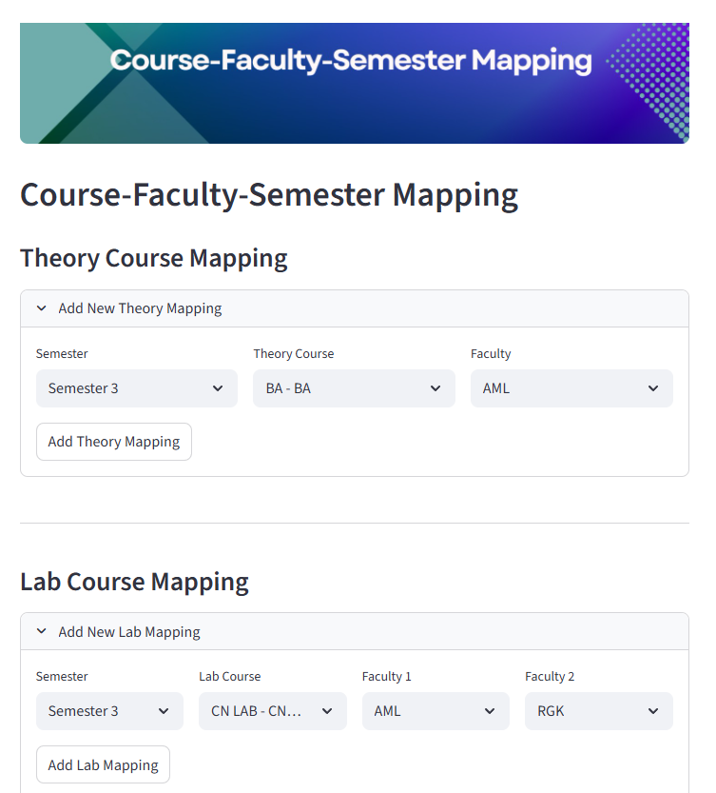
Course management and Course faculty Sem mapping page

Slide 13
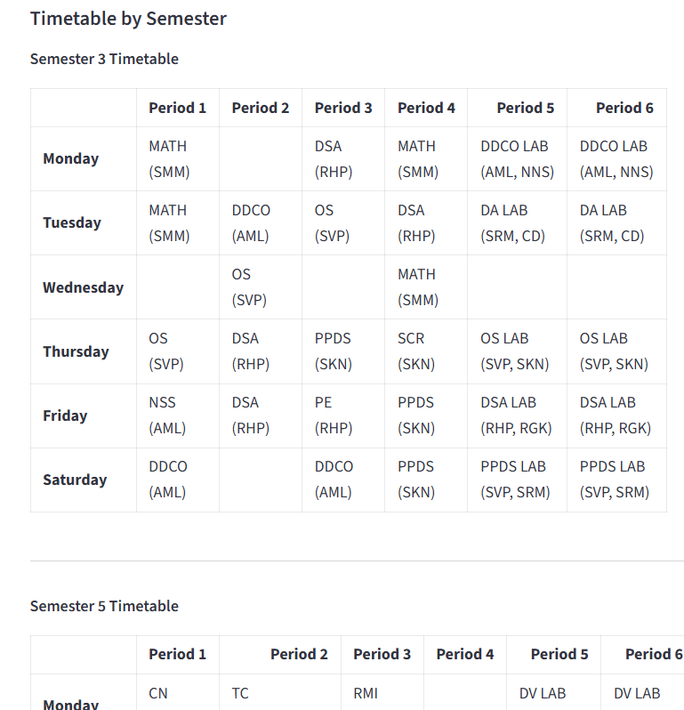
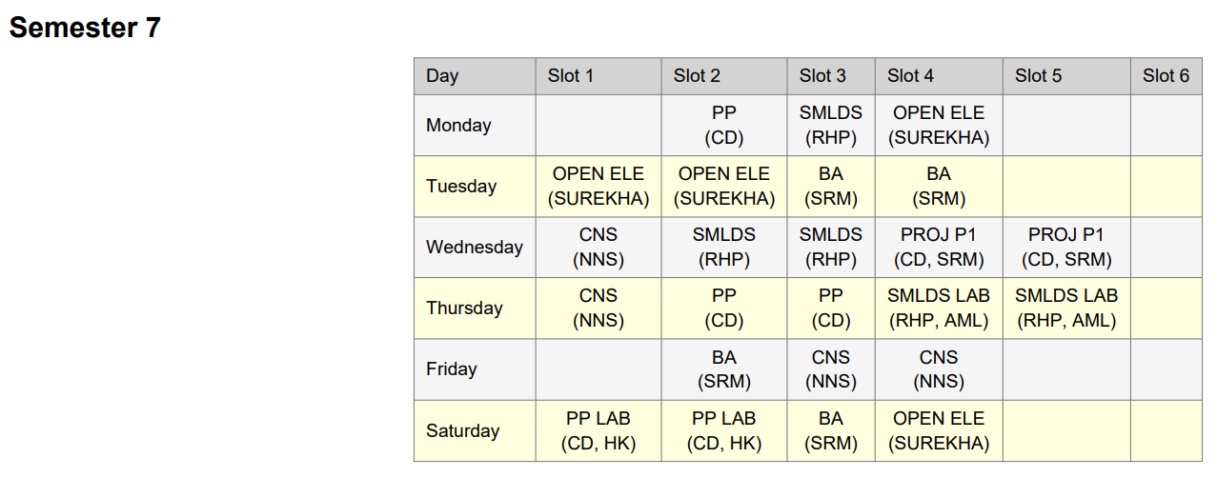
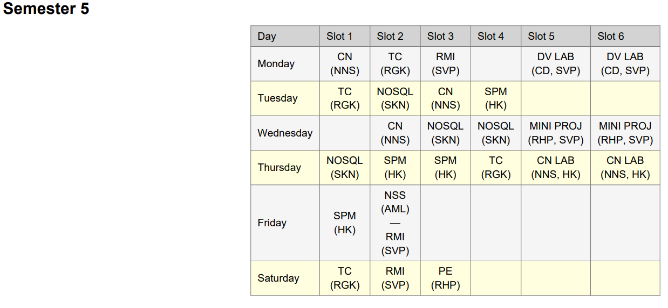
Generated Timetable and Downloaded Timetable

Slide 14
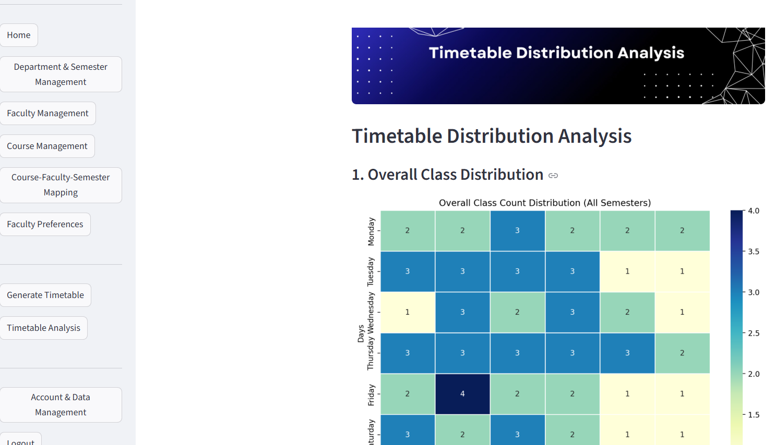
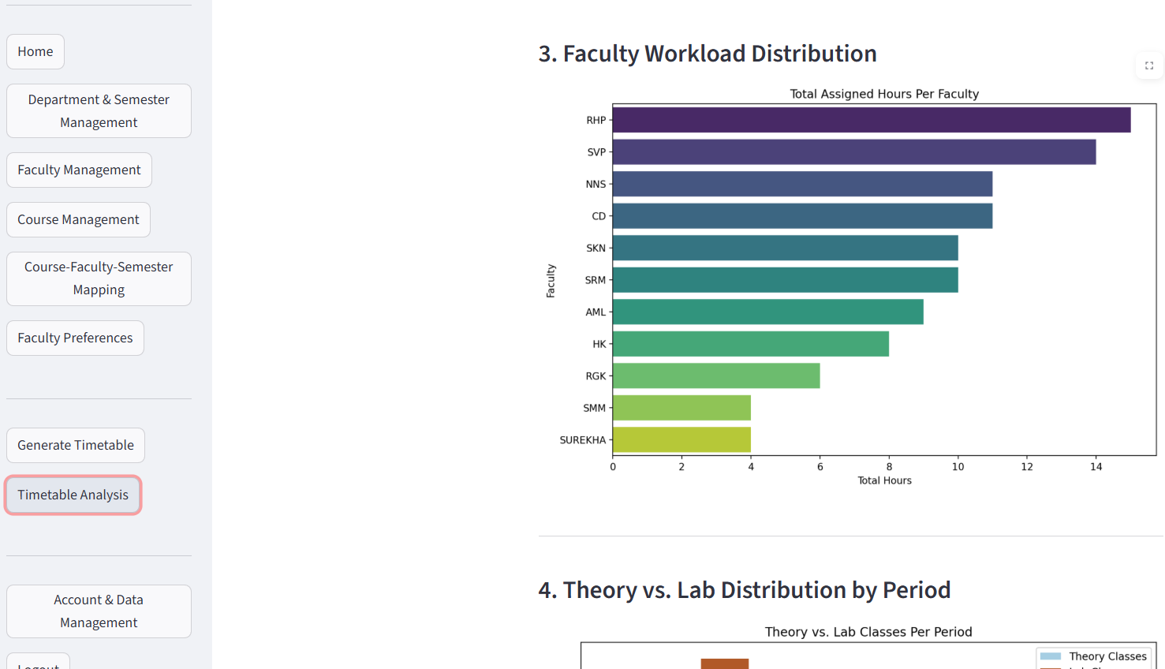
Timetable Visualisation

Slide 15
Conclusion
The Web-Based Automatic Timetable Scheduler effectively automates the process of academic timetable generation using a Genetic Algorithm. The system produces conflict-free schedules while considering faculty availability and institutional constraints. It reduces manual effort, improves scheduling accuracy, and provides a reliable solution for real-world academic environments.

Slide 17
Genetic Algorithm
Genetic algorithms are commonly used to generate high-quality solutions to optimization and search problems via biologically inspired operators such as selection, crossover, and mutation.
Creating Random Timetables – The system first creates many random timetable options.
Checking for Mistakes – It examines each timetable to see if there are any clashes, like a teacher being assigned to two classes at the same time.
Picking the Best Ones – The system selects the best schedules that have fewer mistakes.
“Selects the best, rejects the rest”
Mixing and Matching – It takes the best schedules and combines them to create even better ones.
Making Small Changes – Tiny changes are made to improve the timetable further.
Repeating the Process – This cycle continues until the system finds the most perfect timetable possible.

